Slide 1
Univariate models

Slide 2
Models of modes of evolution (Hunt 2006)

Slide 3
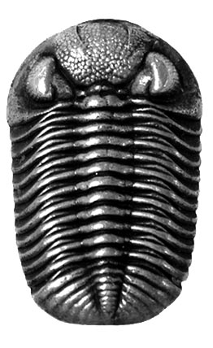
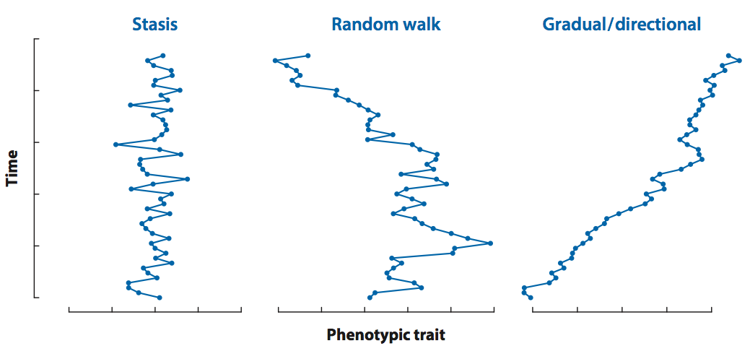
Models of modes of evolution (Hunt 2006)
Stasis
Phenotypic change
Phenotypic change
Phenotypic change

Slide 4
Models of modes of evolution (Hunt 2006)
Phyletic gradualism
Directional
change
Stasis
Random walk
Phenotypic change
Phenotypic change
Phenotypic change

Slide 5
Models of modes of evolution (Hunt 2006)
Phyletic gradualism
Directional
change
Stasis
Random walk
Phenotypic change
Phenotypic change
Phenotypic change

Slide 6
Adaptive zones, not only the animals occupying them, evolve.
G.G. Simpson (1944, p. 190)

Slide 7
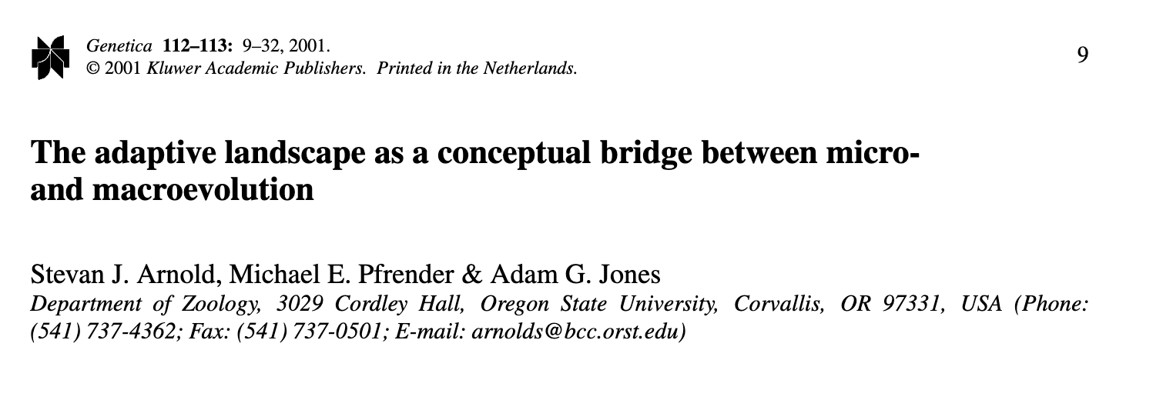
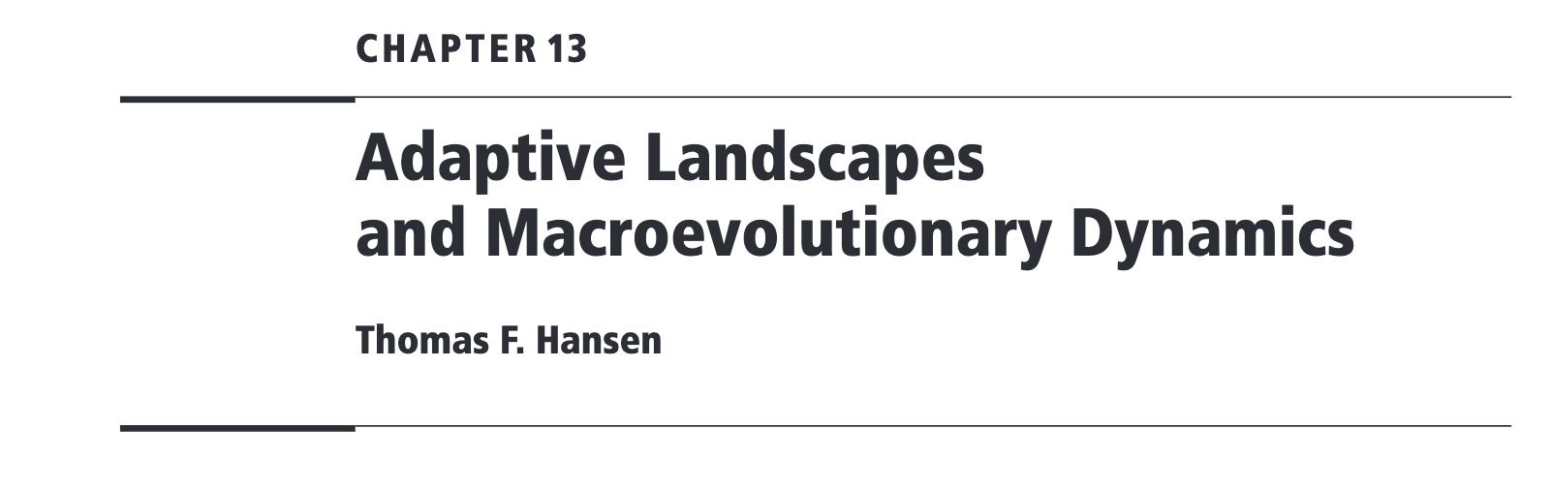
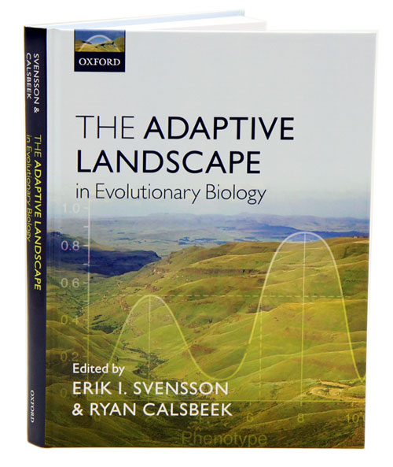

Slide 8
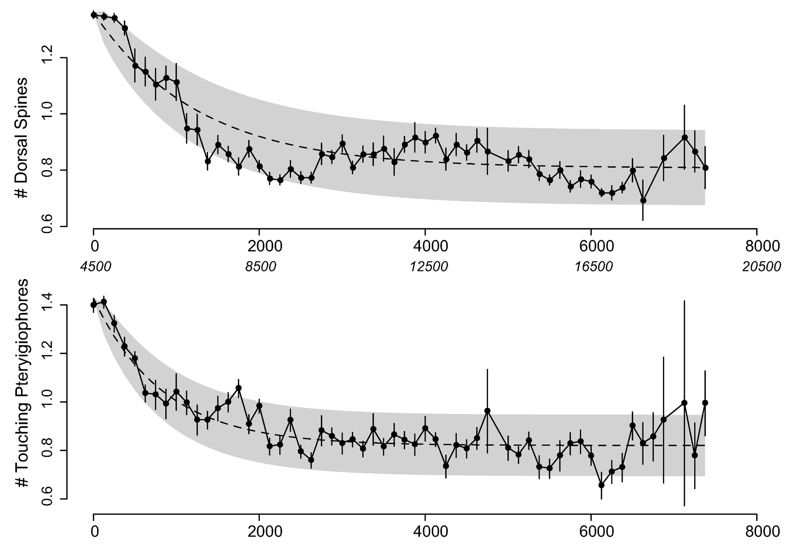
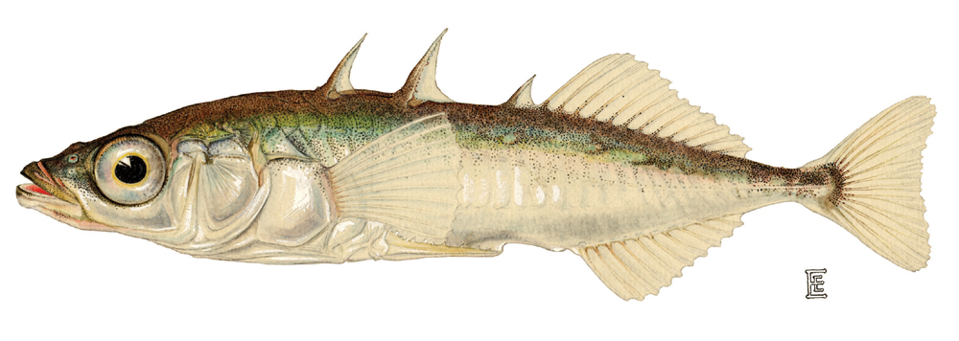
Ornstein Uhlenbeck processes
Gasterosteus aculeatus
Hunt et al. 2008

Slide 9
Static adaptive landscape

Slide 10
Dynamic adaptive landscape

Slide 11
Ornstein-Uhlenbeck process
The simplest stochastic model that allows evolution toward a specific state.
Hansen 1997

Slide 12
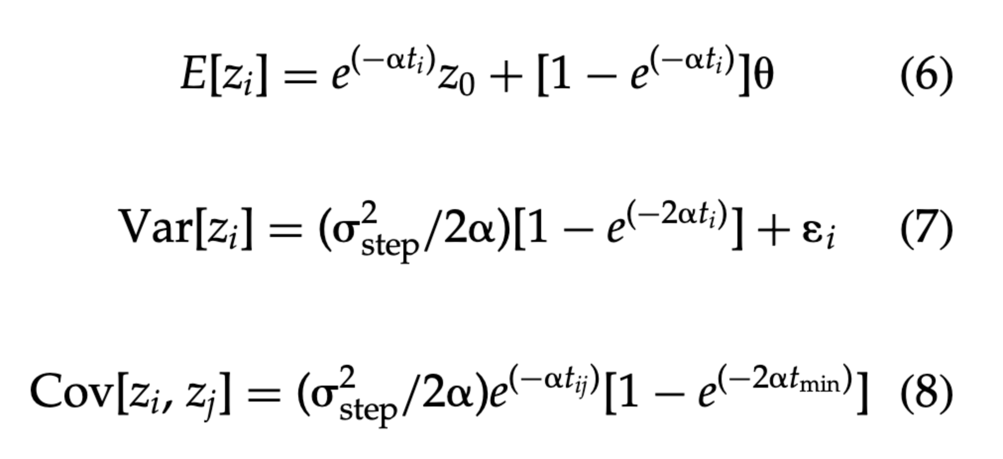
Ornstein-Uhlenbeck process
The simplest stochastic model that allows evolution toward a specific state.
Hansen 1997
Hunt 2008
Time

Slide 13
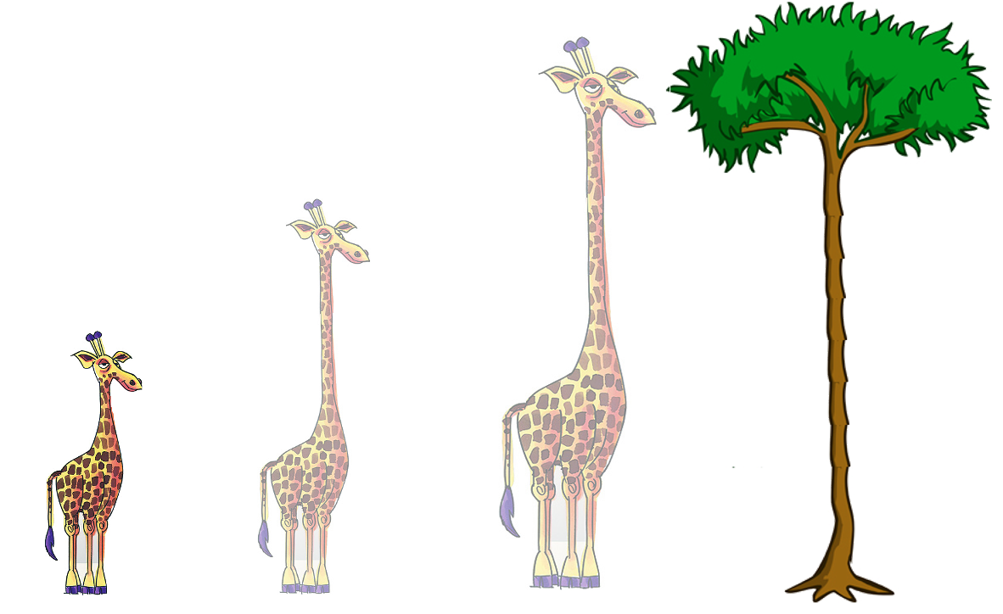
Ornstein-Uhlenbeck process
Time

Slide 14
Ornstein-Uhlenbeck process
Time

Slide 15
Ornstein-Uhlenbeck process
Time
Time

Slide 16
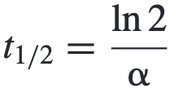
Ornstein-Uhlenbeck process
Time
Time

Slide 17
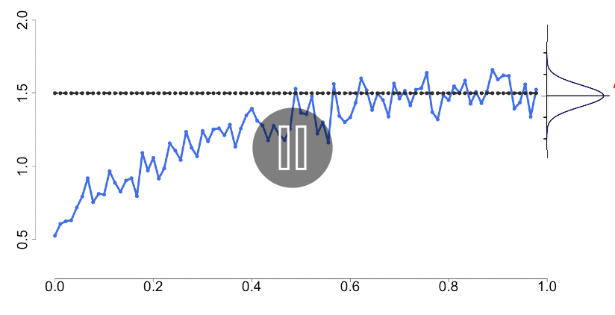
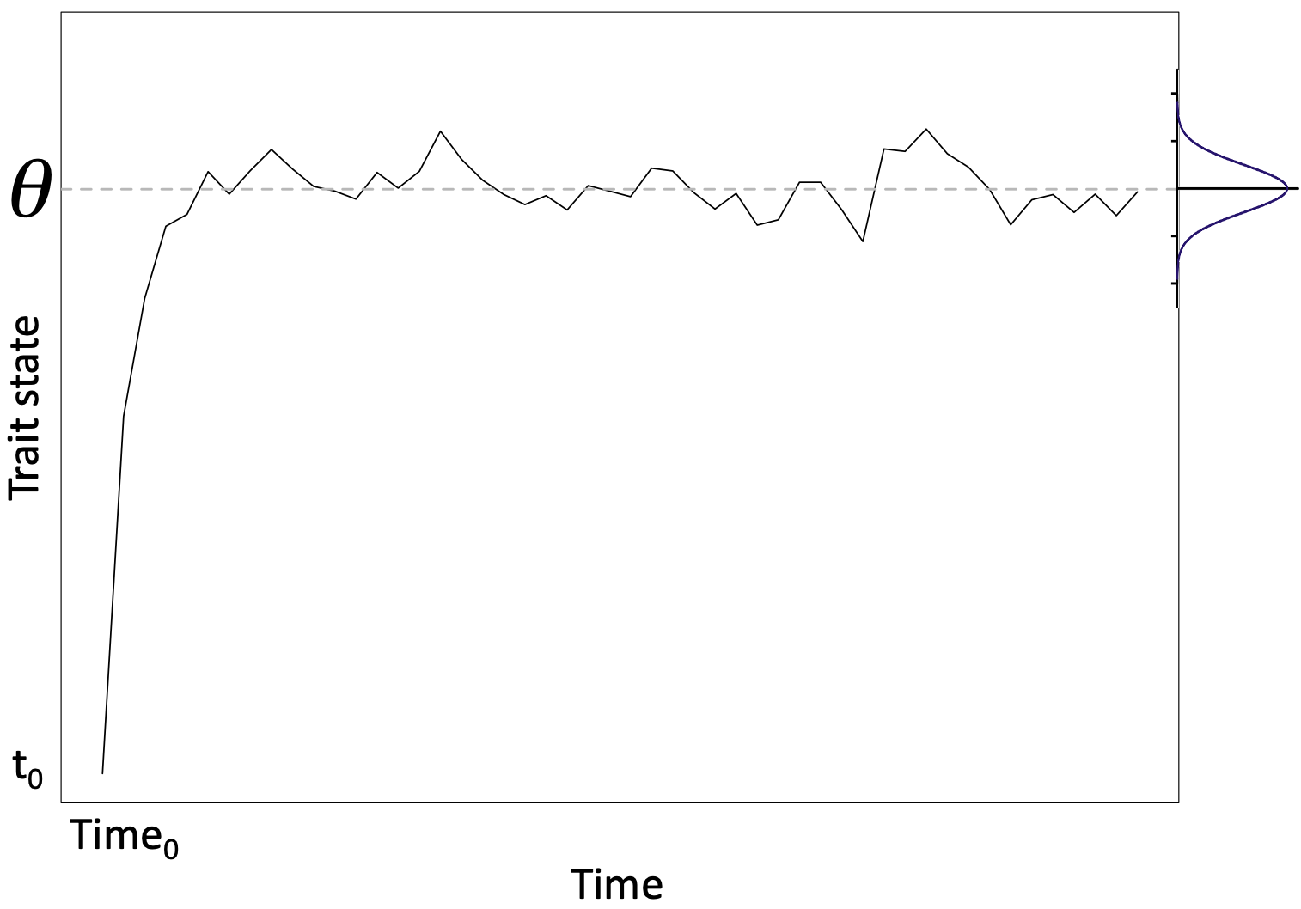
Ornstein-Uhlenbeck process
Time
Time

Slide 18
Ornstein-Uhlenbeck process
Time
Time

Slide 19
Ornstein-Uhlenbeck process
Voje 2023
Time
Time

Slide 20
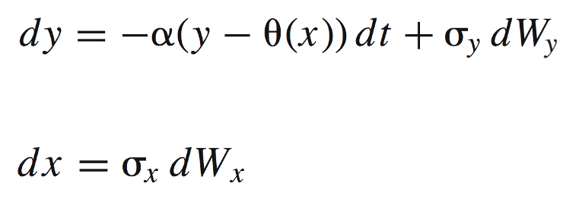
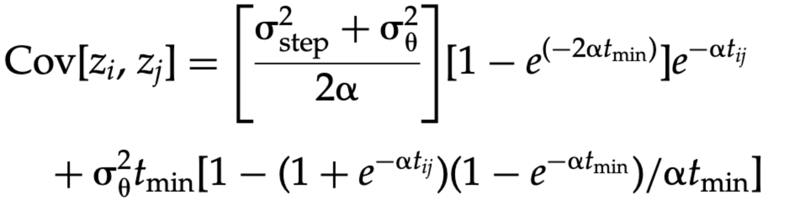
Ornstein-Uhlenbeck process
Voje 2023

Slide 21
Ornstein-Uhlenbeck process
Voje 2023

